Slide 1

CYBER SECURITY
- Ashwin Phadke

Slide 2
STATISTICS
More than 4,000 ransomware attacks have occurred every day since the beginning of 2016.
In 2016, the U.S government spent a whopping $28 billion on cyber security — and this is expected to increase in 2017 – 2018.
The average amount demanded after a ransomware attack is $1,077.
1 in 131 emails contains a malware.
In 2017, 6.5 percent of people are victims of identity fraud — resulting in fraudsters defrauding people of about $16 billion.
Unfilled cyber security jobs are expected to reach 3.5 million by 2021 — compared to about 1 million in 2016.
230,000 new malware samples are produced every day — and this is predicted to only keep growing.
China is the country with highest number of malware-infected computers in the world.
78 percent of people claim to know the risks that come with clicking unknown links in emails and yet still click these links.
Android is the second most targeted platform by hackers after Windows.

Slide 3


Slide 4
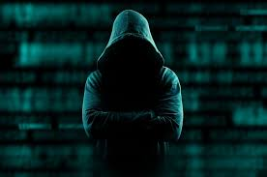
THIS GUY IS FAMILIARLY UNFAMILIAR

Slide 5
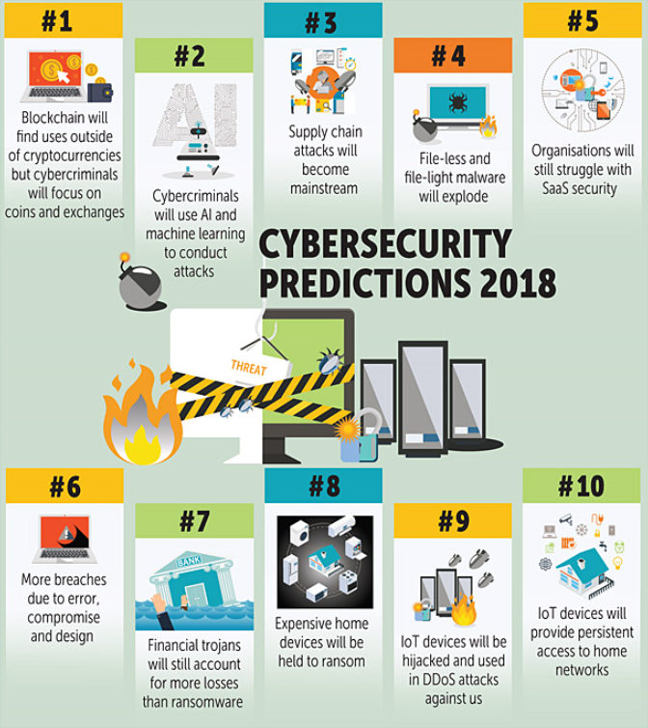

Slide 6
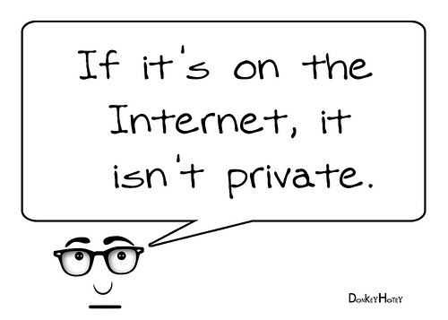

Slide 7
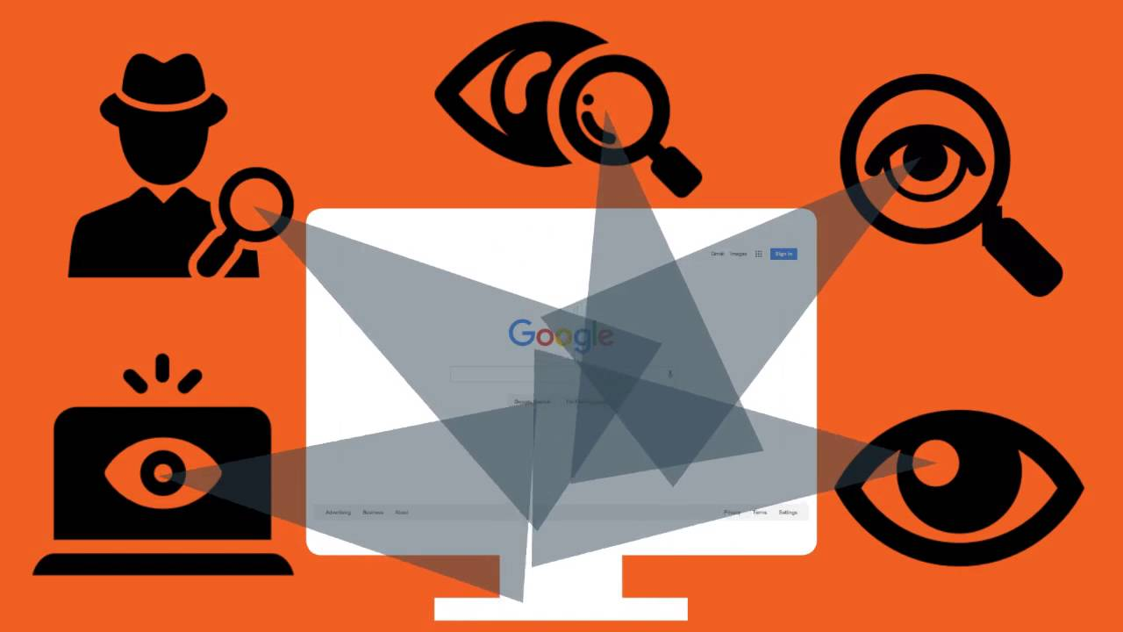

Slide 8


Slide 9
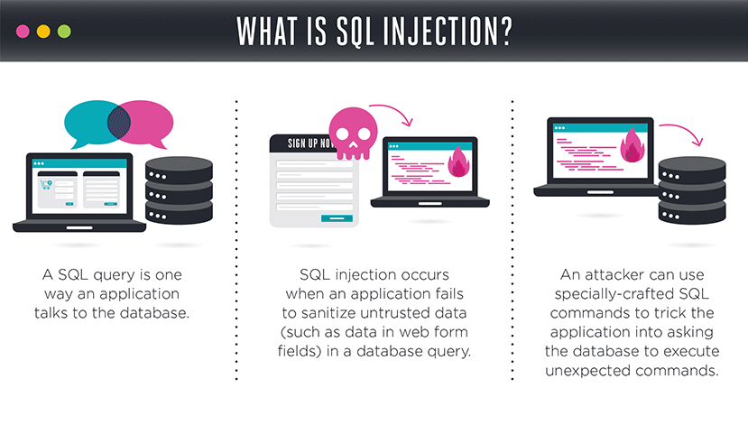

Slide 10
BROWSER SNIFFING
JAVASCRIPT ATTACKS
BROWSER SECURITY
CANVAS FINGERPRINTING
INFECTED TERMINAL

Slide 11


Slide 12
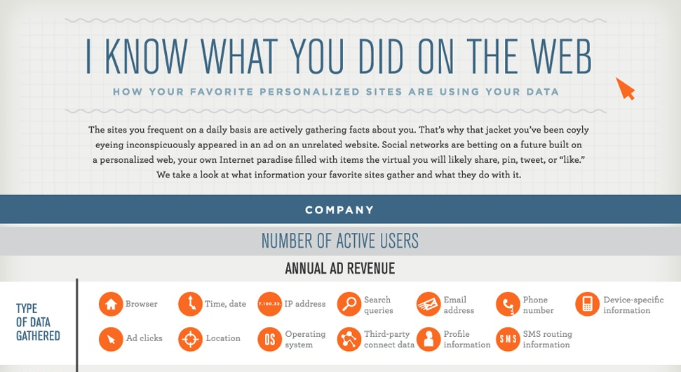

Slide 13

How to define Android :
Someone is hearing, seeing and
knowing whatever you do with your
“SMART” phone

Slide 14
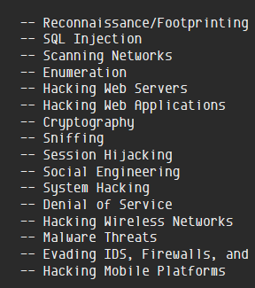

SCOPE OF CYBER ATTACKS:

Slide 15
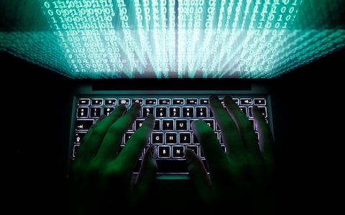
HEARD THEM ANYWHERE ?
SPECTRE AND MELTDOWN
WANNACRY
NOTPETYA
UBER
YAHOO
EQUIFAX
VISA CARD

Slide 16
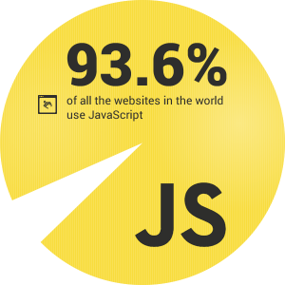
JAVASCRIPT VULNERABILITIES

Slide 17

CAN IT BE YOUR CAREER ?

Slide 18


SO WHO’S GONNA SAVE ME FROM THIS T-REX

Slide 19



TIPS
DUCK DUCK GO .
TORR
VPN
TWEAK YOUR PRIVACY SETTINGS
USE A GOOD ANTIVIRUS
BETTER BE PROTECTED AGAINST MALWARE , ADWARE
USE OPEN SOURCE SOFTWARE(LINUX)
SECURE YOUR ROUTER
GET A DECENT LOOK AT SETTINGS.
BE AWARE
AND A FEW VOCAL TIPS : YEAH ! THEY ARE WATCHING

Slide 20
ASHWIN PHADKE
TELEGRAM : T.ME/AshwinPhadke
GITHUB : ASHWIN-PHADKE
WEBSITE : Ashwin-Phadke.github.io
CONTACT : +919860386639
TWITTER : @ASHWINPHADKE1
THANK YOU

